Slide 1

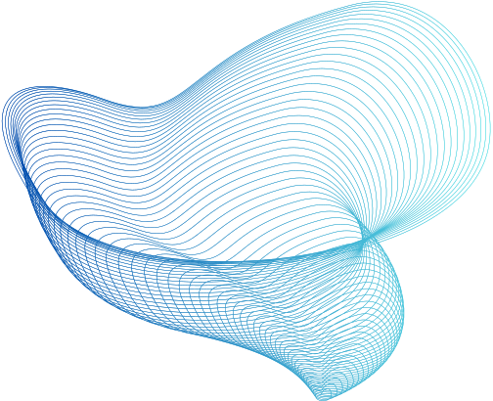

Indian Institute of Information Technology
Dharwad
ALGORITHMS AND ARTIFICIAL INTELLIGENCE
COMPARITIVE ANALYSIS OF GOOGLE TRANSLATOR AND AI4BHARAT TRANSLATOR
- A TRANSLATION TECHNOLOGY STUDY
COURSE INSTRUCTOR : DR.ANIMESH CHATURVEDI

Slide 2


OUR TEAM
A. SARAS CHANDRIKA - 21BDS003
CH . SRINIVASA SAI - 21BDS012
R . VINAY KUMAR - 21BDS056

Slide 3
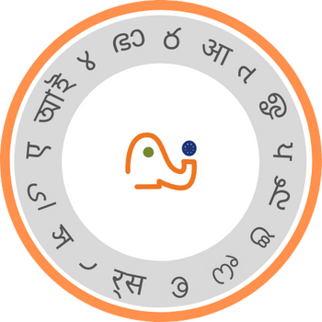


OVERVIEW OF GOOGLE TRANSLATOR AND AI4BHARAT
Both Google Translate and AI4Bharat are significant players in the field of machine translation, but they have different focuses and strengths
Focus of google translator is global translation across a vast number of languages (over 100)
Focus of ai4bharat translator is on Indian languages, they are 22 scheduled languages, including multiple scripts for low-resource languages)
GOOGLE TRANSLATOR
AI4 BHARAT TRANSLATOR

Slide 4



PROBLEM STATEMENT
In light of Google Translator's inefficiencies with low-resource and certain Indian languages, can we find more effective alternatives to Google Translator?How do these alternatives compare in terms of accuracy and contextual meaning, aiming to deliver superior translations in diverse linguistic contexts?
MOTIVATION
Encountering challenges with Google Translator's inefficiencies in low-resource languages, the motivation behind opting for AI4Bharat Translator is twofold. Not only does it specialize in Indian languages, but it also addresses the pressing issue of accurately translating low-resource languages, promising a more comprehensive and effective solution for cross-lingual communication

Slide 5



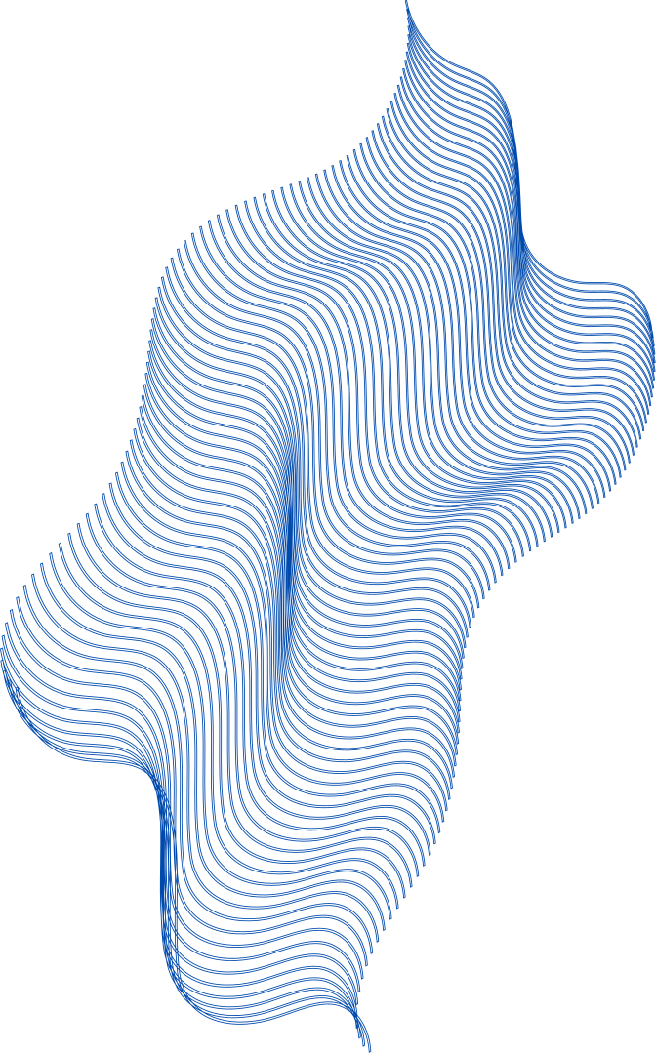
TRAINING METHODS OF GOOGLE TRANSLATOR
NEURAL MACHINE TRANSLATION (NMT) :
The core technology behind Google Translate is NMT.
NMT uses artificial neural networks trained on massive amounts of bilingual text data.
These networks learn the relationships between words and phrases across languages, allowing them to generate translations that are more natural and accurate than traditional methods.
NMT
SMT
STATISTICAL MACHINE TRANSLATION (SMT) :
While NMT is the dominant approach, SMT still plays a role in Google Translate.
SMT uses statistical analysis of large parallel text corpora to identify patterns and translate text based on these patterns.

Slide 6
NMT VS SMT
Feature | Neural Machine Translation | Statistical Machine Translation
Mechanism | It translates sentence by sentence. | It translates word by word or phrase by phrase.
Underlying Model | Utilizes attentional decoder-encoder networks, often deep learning models like Recurrent Neural Networks (RNNs) or Transformers. | Relies on statistical models based on linguistic and probabilistic principles. Commonly uses phrase-based or word-based models.
Multilingual/Multi-domaintranslation | NMT excels in seamlessly handling multilingual translation and adapting to diverse domains through shared parameters and contextual learning. | SMT, on the other hand, may face challenges in efficiently managing multiple languages and domains, often requiring separate models and significant retraining.
Vocabulary/Rare word Problem | NMT models, with continuous embeddings, tend to handle rare words better, capturing nuanced meanings effectively. | SMT systems may struggle with rare words, relying on predefined vocabularies and facing challenges in accurately translating less common terms.

Slide 7
TRANSLATION DONE USING GOOGLE TRANSLATOR :
Hindi | English | Eng_Trans
ऐ मेरे बन्दों! आज न तुम्हें कोई भय है और न तुम शोकाकुल होगे। | O My servants, today no fear is on you, neither do you sorrow | O my prisoners! Today you have no fear nor you will be heartbroken
वही है जो आकाशों में भी पूज्य है और धरती में भी पूज्य है और वह तत्वदर्शी, सर्वज्ञ है | And it is He who in heaven is God and in earth is God; He is the All - wise, the All - knowing. | He is the one who is also revered in the sky and is also revered in the earth and he is a philosopher, omnisc.
रहे वे लोग जिन्होंने इनकार किया, तो उनके लिए तबाही है। और उनके कर्मों को अल्लाह ने अकारथ कर दिया | But as for the unbelievers, ill chance shall befall them! He will send their works astray. | Those who refused, so there is havoc for them.And Allah made their deeds unconscious
फिर कैसी रही मेरी यातना और मेरे डरावे? | How then were My chastisement and My warnings? | Then how was my torture and my scared?

Slide 8
TRAINING METHODS OF AI4BHARAT
TRANSFORMER-BASED MULTILINGUAL NMT:
This model uses the powerful Transformer architecture, originally developed for Google Translate, but specifically tailored for Indic languages.
It allows for parallelized processing and attention mechanisms, leading to faster training and better performance.
MULTILINGUAL TRAINING :
The model is trained on a massive dataset of parallel text across all 22 scheduled Indic languages and English.
This enables it to learn the relationships between different languages and generate accurate translations.
SCRIPT UNIFICATION:
To leverage lexical sharing between languages, IndicTrans2 adopts script unification wherever feasible.
This means that languages like Kashmiri, Manipuri, and Sindhi, which use different scripts, are converted to a common script like Devanagari before translation and then converted back after translation.

Slide 9
TRANSLATION DONE USING AI4BHARAT TRANSLATOR :
Hindi | English | AI4_Bharat_trans
ऐ मेरे बन्दों! आज न तुम्हें कोई भय है और न तुम शोकाकुल होगे। | O My servants, today no fear is on you, neither do you sorrow | O My servants! Today you will have no fear nor will you grieve
वही है जो आकाशों में भी पूज्य है और धरती में भी पूज्य है और वह तत्वदर्शी, सर्वज्ञ है | And it is He who in heaven is God and in earth is God; He is the All - wise, the All - knowing. | He is the one who is God in the heavens and God on the earth. He is the Wise and the All Knowing.
रहे वे लोग जिन्होंने इनकार किया, तो उनके लिए तबाही है। और उनके कर्मों को अल्लाह ने अकारथ कर दिया | But as for the unbelievers, ill chance shall befall them! He will send their works astray. | But as for those who disbelieve, for them is perdition. And He will waste their deeds.
फिर कैसी रही मेरी यातना और मेरे डरावे? | How then were My chastisement and My warnings? | How [terrible] were My punishment and My warnings!

Slide 10
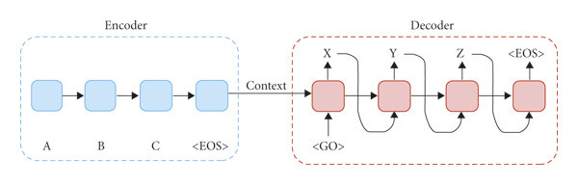
GOOGLE TRANSLATOR (NMT) ARCHITECTURE
ENCODER-DECODER ARCHITECTURE
The fundamental architecture common to both Neural Machine Translation (NMT) and Statistical Machine Translation (SMT) models involves an encoder that compresses the source language text, and a decoder that utilizes this representation to generate the translated text in the target language.
ATTENTION MECHANISM
Attention mechanism, a crucial component of NMT models, enhances translation accuracy and fluency by enabling the decoder to focus on specific parts of the encoded source language text during the generation of translations.

Slide 11
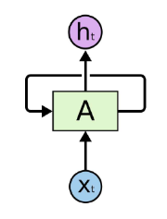
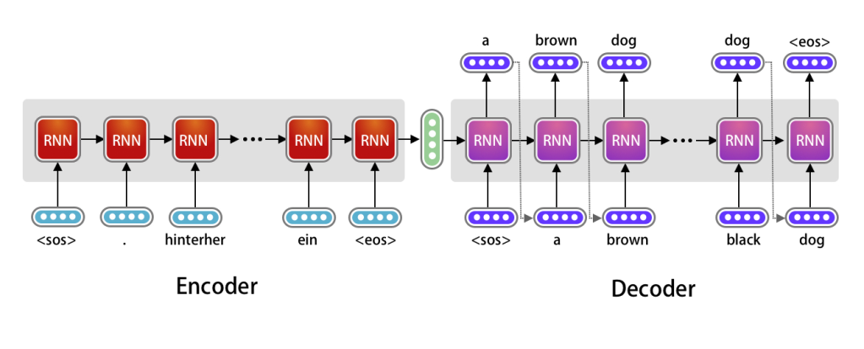
MULTI-LAYER PERCEPTRON
Used in both NMT and SMT models to process the encoded representation and generate the translated text.
LONG SHORT-TERM MEMORY (LSTM) NETWORKS
These are a type of recurrent neural network used in some NMT models to capture long-range dependencies in the source language text, which is important for accurate translations of complex sentences.

Slide 12
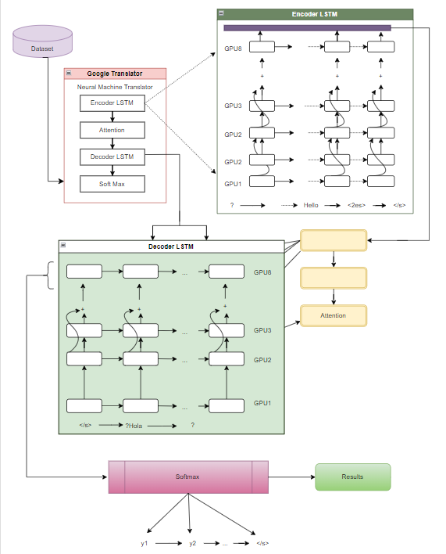
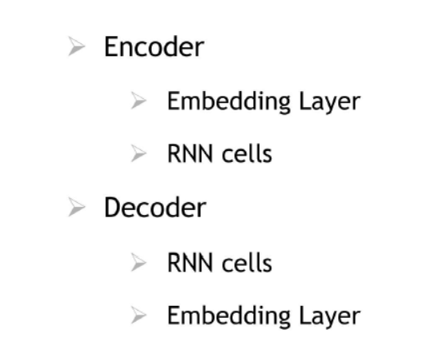
NMT COMPONENTS

Slide 13

INDICTRANS2 NEURAL TRANSLATION ARCHITECTURE
ENCODER-DECODER ARCHITECTURE
IndicTrans2, akin to Google Translate, utilizes an encoder-decoder architecture where the encoder compresses the source language text into a hidden representation, and the decoder subsequently employs this representation to produce the translated text in the target language.
MULTI-HEAD ATTENTION
This mechanism allows the decoder to attend to different parts of the encoded source language text, leading to more context-aware translations.
POSITIONAL ENCODING
This technique helps the model understand the order of words in the sentence, which is crucial for accurate translations of languages with complex syntax like Hindi and Urdu.

Slide 14
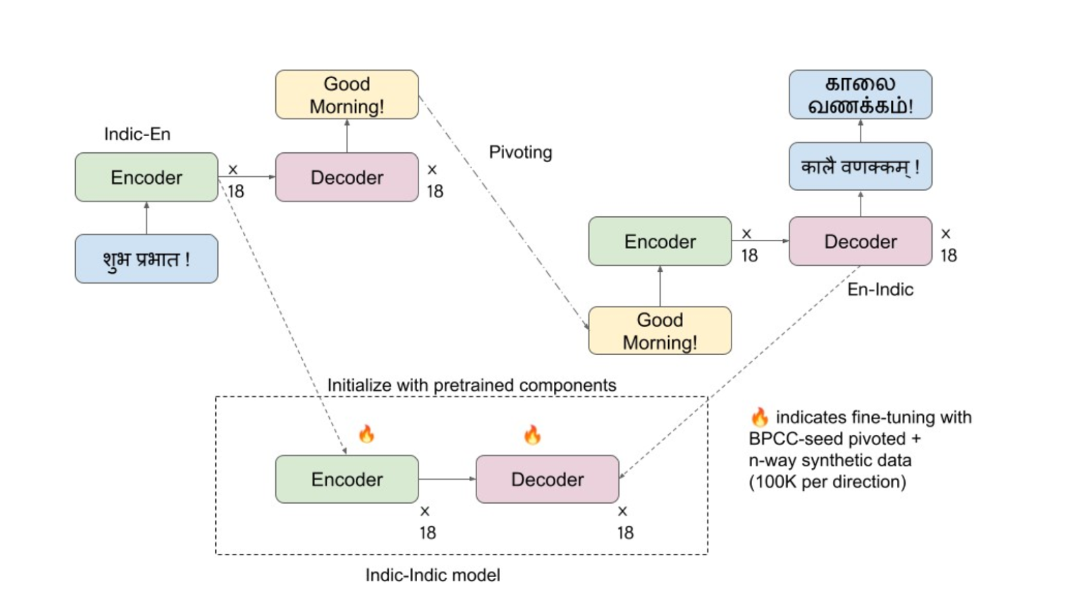

RESIDUAL CONNECTIONS
These connections allow the model to learn long-range dependencies in the text, improving the accuracy of translations for longer sentences.

Slide 15


COMPARISON METRICS
SEMANTIC TEXTUAL SIMILARITY (STS) SCORES
STS scores quantify the semantic similarity between two text sentences.
Measures how closely the meaning of two sentences aligns.
HOW IT’S CALCULATED
STS scores typically involve:
Embeddings: Transforming text into numerical representations called "embeddings" in a high-dimensional space.
Similarity measure: Using a mathematical formula (e.g., cosine similarity) to calculate the distance between the two embeddings.
Normalization: Converting the distance into a score between 0 and 1, where 0 means no similarity and 1 signifies perfect similarity.

Slide 16
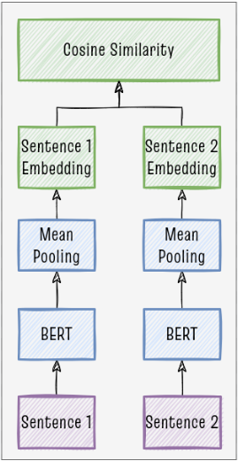

SCORE INTERPRETATION
STS scores typically range between 0 and 1, representing the degree of semantic similarity between two text pieces.
0 : No semantic similarity.
0.5 : Moderate level of similarity.
1 : Perfect semantic similarity, indicating the
two texts convey the same meaning.
BENEFITS
Focuses on meaning
Human-like evaluation
Comparative analysis
Targeted improvement
TRANSLATORS_COMPARSION

Slide 17
FINAL RESULTS :
English | Eng_Trans | AI4_Bharat_trans | Score_for_google_trans | Score_for_AI4bharat
O My servants, today no fear is on you, neither do you sorrow | O my prisoners! Today you have no fear nor you will be heartbroken | O My servants! Today you will have no fear nor will you grieve | 0.2912 | 0.5101
And it is He who in heaven is God and in earth is God; He is the All - wise, the All - knowing. | He is the one who is also revered in the sky and is also revered in the earth and he is a philosopher, omnisc. | He is the one who is God in the heavens and God on the earth. He is the Wise and the All Knowing. | 0.0531 | 0.9191
But as for the unbelievers, ill chance shall befall them! He will send their works astray. | Those who refused, so there is havoc for them.And Allah made their deeds unconscious | But as for those who disbelieve, for them is perdition. And He will waste their deeds. | 0 | 0.7391
How then were My chastisement and My warnings? | Then how was my torture and my scared? | How [terrible] were My punishment and My warnings! | 0 | 0.2606

Slide 18


THANK
YOU

